Slide 1

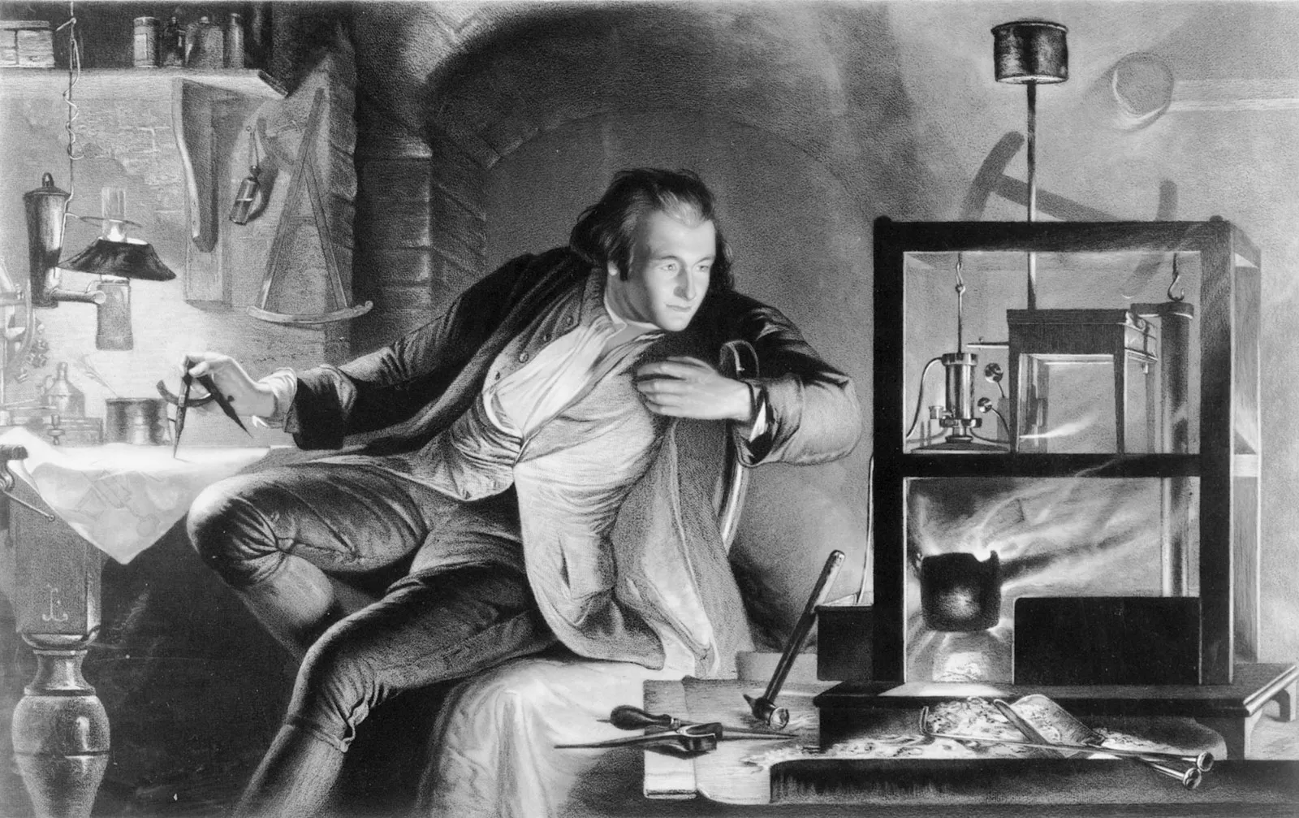
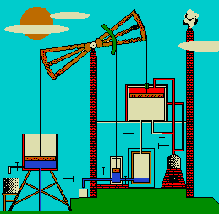
JAMES WATT’S STEAM ENGINE
A steam engine is a mechanical device that uses the power of steam to perform mechanical work.
It operates by harnessing the pressure created by heated water turning into steam, which drives pistons or turbines to produce motion, often used for powering machinery or transportation.
James Watt, the Scottish inventor born in 1736, transformed the world with his revolutionary improvements to the steam engine.
The steam engine, pioneered by inventors like James Watt, held immense significance as it became the driving force behind the Industrial Revolution.
Notes:
Thanks Sarah
Goodafternoon everyone, I am Tinu
I am going to talk about Jameswatt steam engine.
James Watt, the Scottish inventor born in 1736, transformed the world with his revolutionary improvements to the steam engine.
The steam engine held immense significance as it became the driving force behind the Industrial Revolution.
A steam engine is a mechanical device that uses the power of steam to perform mechanical work/ to generate power.
The basic principle involves heating water to produce steam, which then drives pistons or turbines to create mechanical motion.
This motion can be used to power machinery, locomotives, ships, and other vehicles.
After doing work, the steam loses its energy and condenses back into water.
This condensed water is collected and reused to produce steam again.

Slide 2
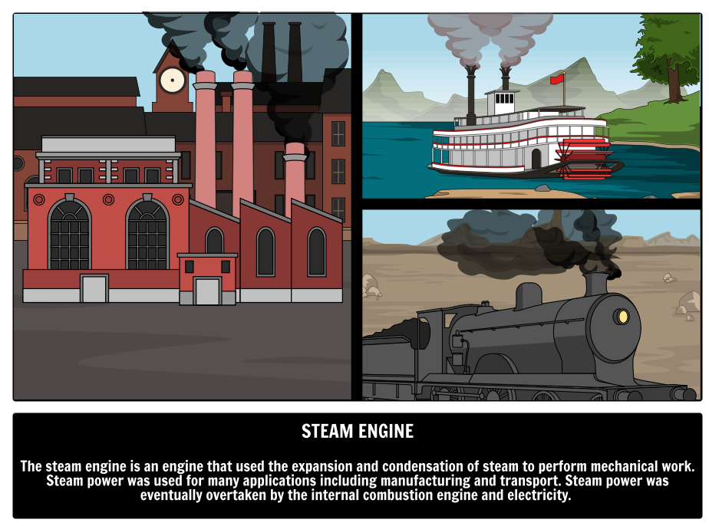
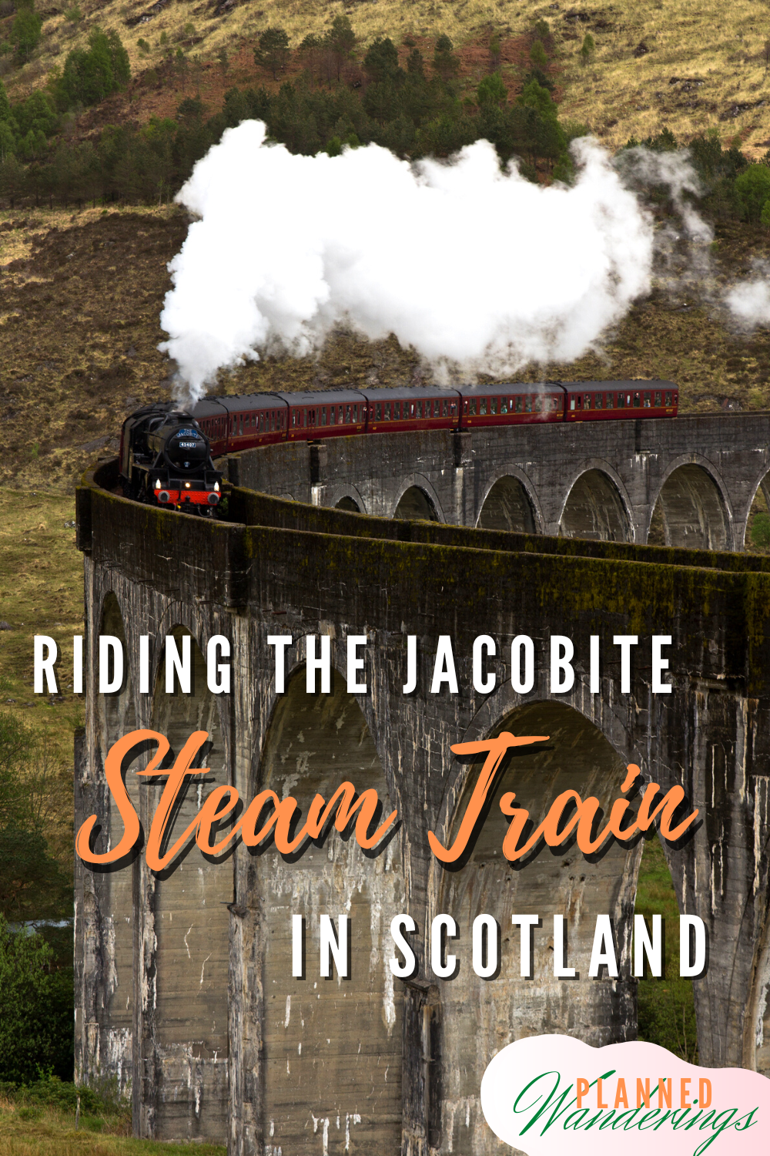
Innovations of Watt’s Design and the Impact of Steam Engine
James Watt’s Steam engine’s key enhancements: Separate condenser, Rotary motion, Economical fuel consumption, Precise engineering and design.
The Jacobite steam train
The greatest train journey in the world
James Watt's improved steam engine had a profound impact on various industries and applications during the Industrial Revolution:
Manufacturing
Mining
Transportation
Factories
Agriculture
Urban development
Thankyou Tinu
Notes:
Separate Condenser: greatly increasing efficiency.
Rotary Motion:
Economical Fuel Consumption: Watt's engine consumed less
Precise Engineering and Design: contributed to the overall efficiency and reliability of the steam engine.
These enhancements revolutionized the steam engine,
turning it into a more efficient, adaptable, and commercially successful machine, which became the backbone of the Industrial Revolution.
Impact of the Steam Engine
James Watt's improved steam engine had a profound impact on various industries and applications during the Industrial Revolution:
Manufacturing textile industry.
Mining: to drain mines
Transportation: Steam engines powered locomotives and steamships,
Factories: papermaking to metalworking.
Agriculture:, driving threshing machines, grain mills, and other farm equipment, enhancing agricultural productivity.
Urban Development: water pumping
Steam in the Highlands - The Jacobite Steam Train
Has anyone been in the steam engine before? If not
The greatest railway journey in the world Take a ride on The Jacobite steam passenger service from Fort William to Mallaig in the beautiful Scottish Highlands.
The 'West Highland Line' route was featured in the Harry Potter films as the setting for the Hogwarts Express - most notably the viaduct at Glenfinnan.

